Slide 1


Don’t rate limit between your back-end and front-end and
between critical services
Atanas L. Kuzmanov
Senior Software Engineer
Notes:
Don’t rate limit between your back-end and front-end and between critical services

Slide 2





Hello, my name is
Atanas L. Kuzmanov
Senior Software Engineer
IT Solution Development
SchwarzIT Bulgaria
Currently:
Previously:
Notes:
Hi, my name is Atanas
I am a Senior Software Engineer at SchwarzIT Bulgaria
Here is a bit of background about me
- Where do you work?
IT Solution Development Department at Schwarz IT Bulgaria.
- What do you do there?
I am part of the team which develops and maintains our property management CMS systems, and more.
- Why are you talking about this topic?
- Why are you giving this talk today?

Slide 3



A long time ago
Notes:
A long time ago we were transitioning to the dark side and I was leading this effort.
Apigee was still at start-up or post start-up stage.

Slide 4
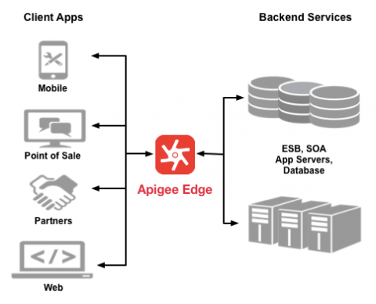
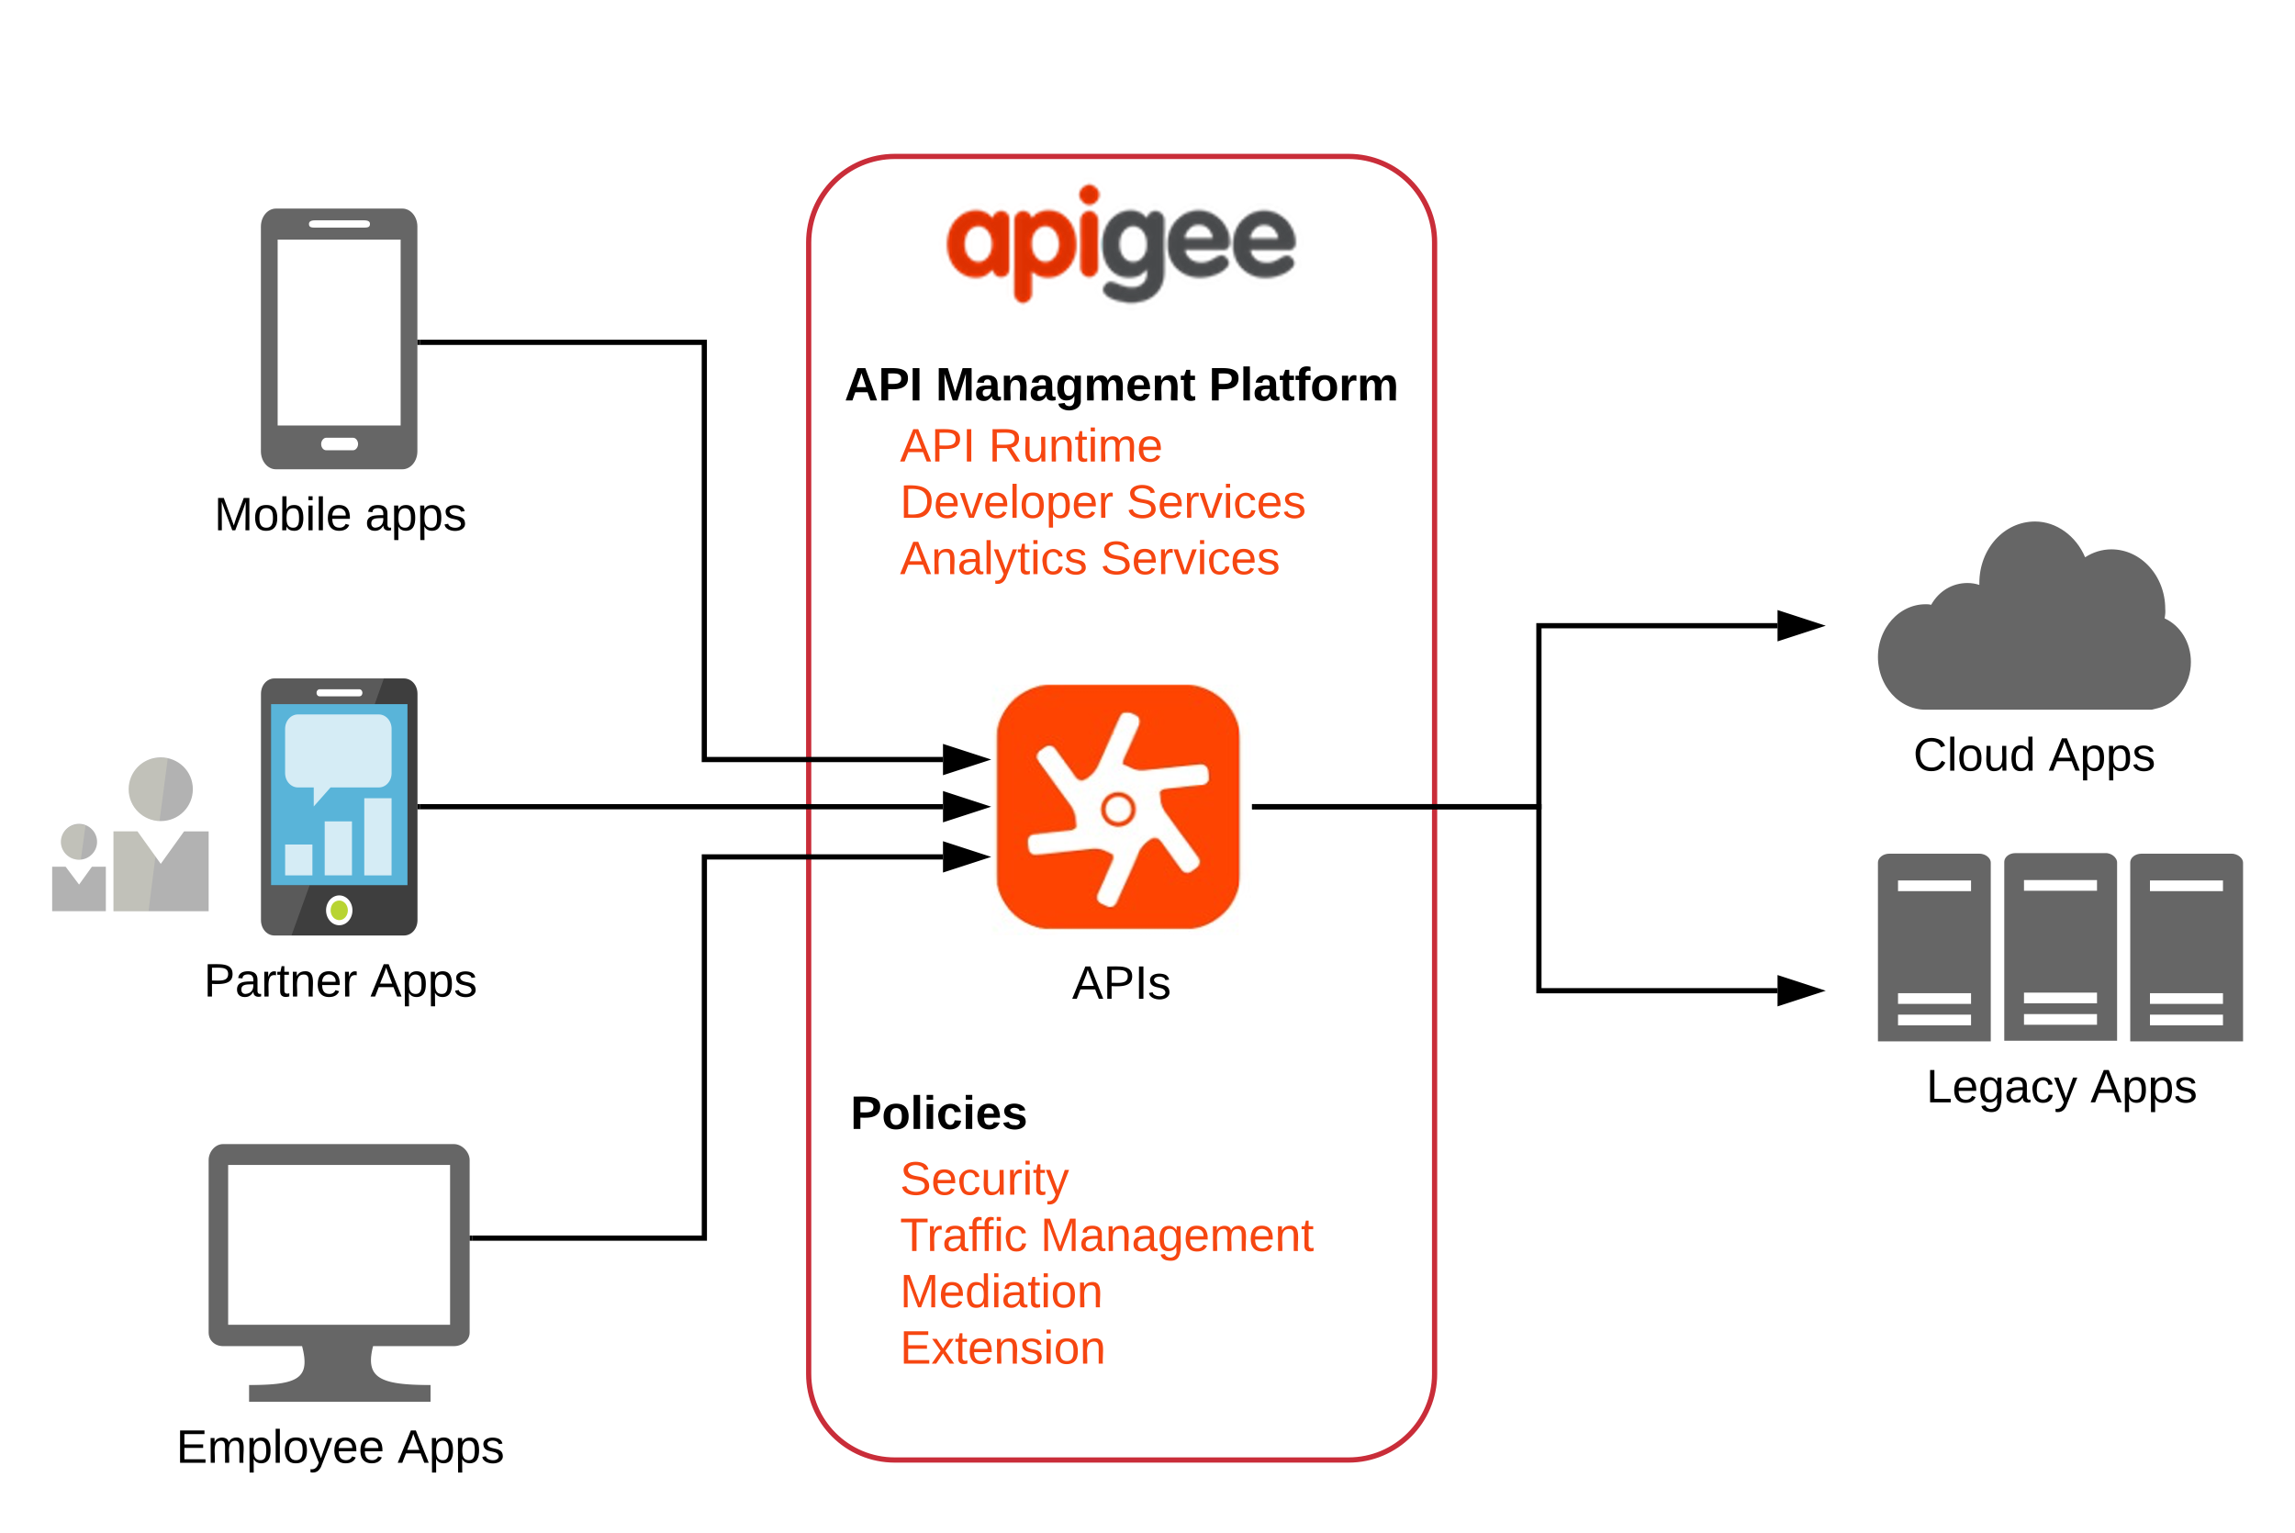
Rate limiting did not perform well under heavy traffic
Notes:
Apigee was supposed to be an API gateway between all services.
Apigee’s rate limiting did not perform well under heavy traffic.
It brought down our critical services and websites.

Slide 5

Notes:
I guess one of the reasons for that was that I am not sure that currently there exists a perfect solution for rate-limiting in a distributed environment.
There are options with the relevant trade-offs you have to be willing to compromise.

Slide 6
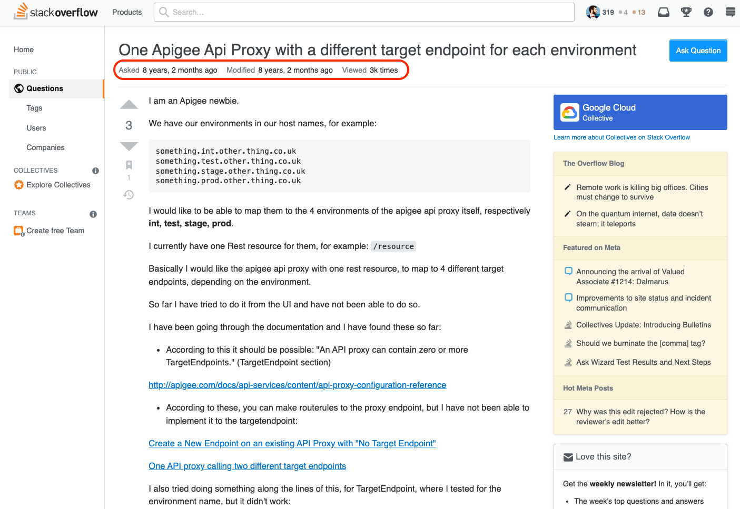
Notes:
Just a couple of examples of some of the issues we were having.

Slide 7
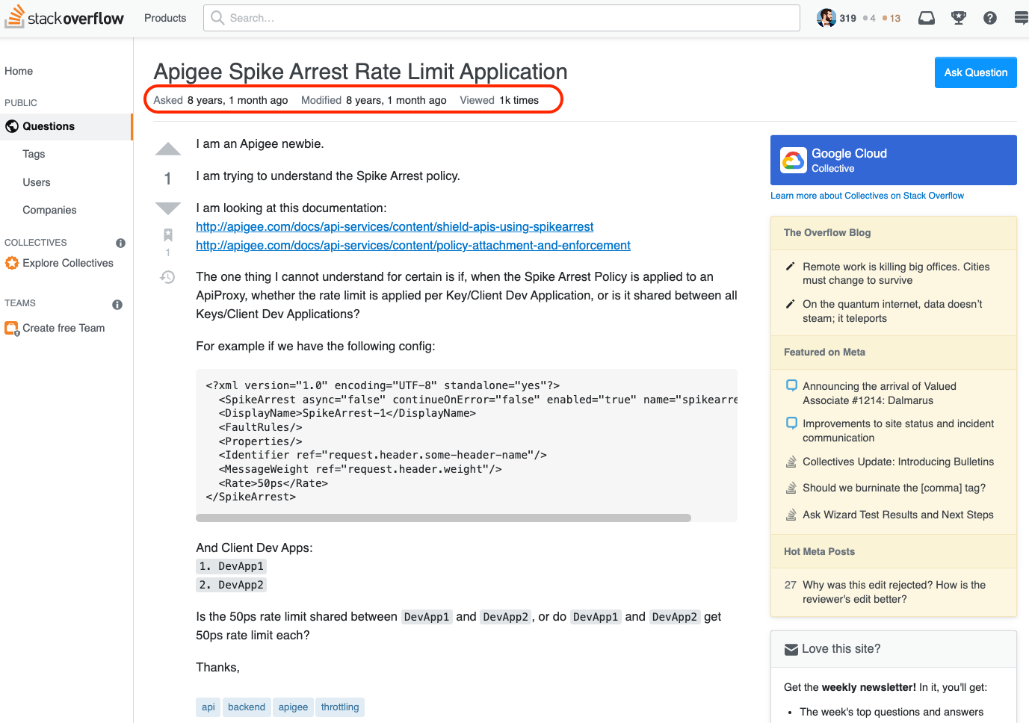
Notes:
Just a couple of examples of some of the issues we were having.

Slide 8
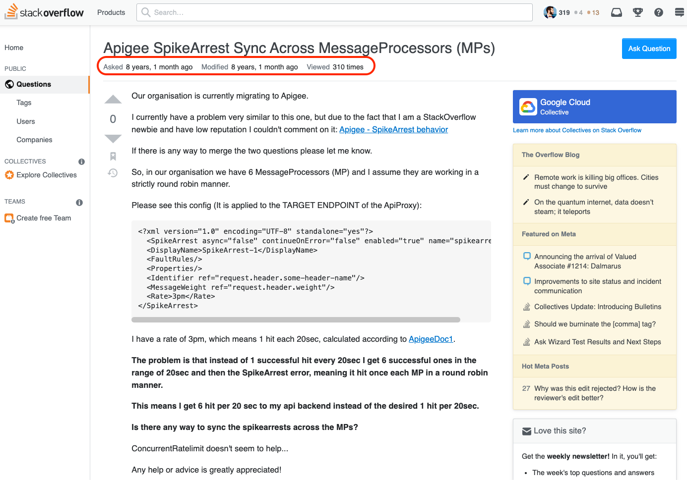
Notes:
Just a couple of examples of some of the issues we were having.

Slide 9
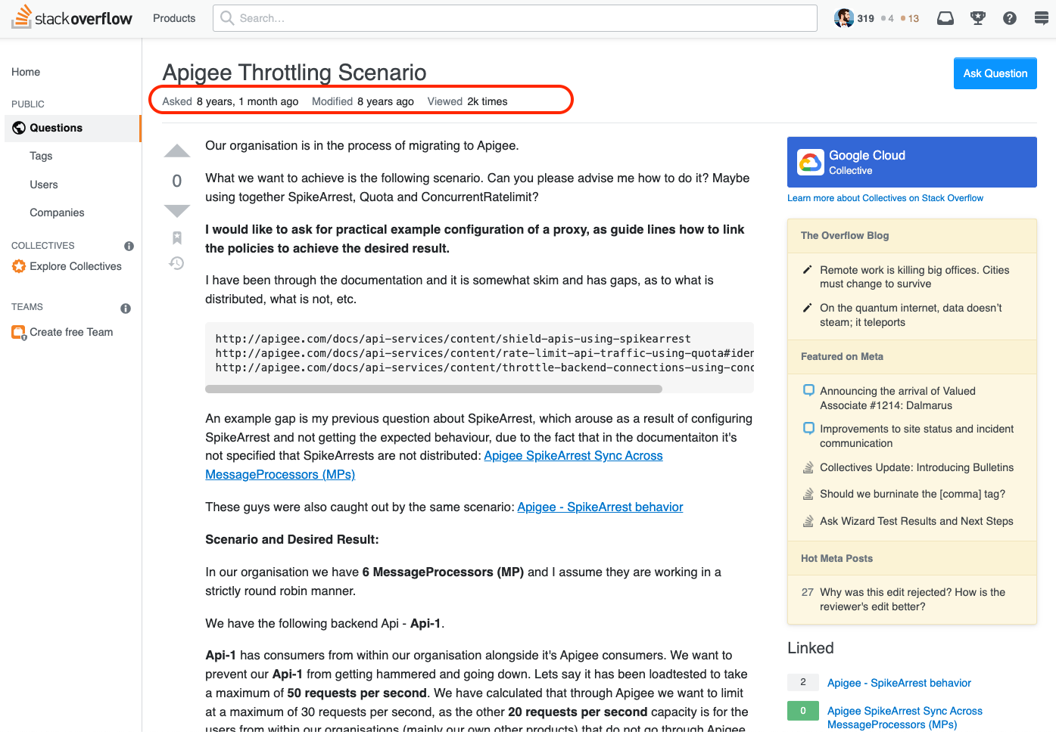
Notes:
Just a couple of examples of some of the issues we were having.

Slide 10
100s more in their internal ticketing system…
Notes:
We had 100s more issues raised in their internal ticketing system…

Slide 11

Notes:
This was one of the most stressful projects we had at the time.
I promised myself that I would never work with Apigee again.

Slide 12

Notes:
But don’t worry I think as long as we are careful we should be fine.

Slide 13

Fast-forward to nowadays
Notes:
Fast-forward to nowadays a couple of weeks ago I went to the jPrime conference.
There I saw some very interesting lectures and met some very knowledgeable people and we exchanged some experience which I will share with you.

Slide 14
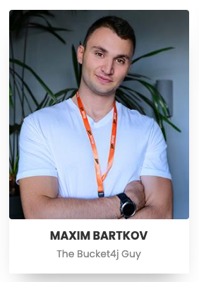


”COMPLEX RATE-LIMITING IS EASY WITH BUCKET4J“
A Java rate-limiting library.
Is memory efficient.
Cannot handle traffic bursts.
“We currently do not have a solution for your example with bursts or spikes of traffic, but I will write to the other co-author, and if we ever find a solution we will contact you.”
Notes:
”COMPLEX RATE-LIMITING IS EASY WITH BUCKET4J“
A Java rate-limiting library.
Is memory efficient.
Cannot handle traffic bursts.
His thoughts were:
”We currently do not have a solution for your example with bursts or spikes of traffic, but I will write to the other co-author, and if we ever find a solution we will contact you.”
It was very flattering as he actually recognised me from my API lecture in the previous conference and was already following me in social media.

Slide 15



”EVOLVING YOUR APIS, A STEP-BY-STEP APPROACH“
Cloud-Native Microservices API Gateway
“Do not rate limit between your back-end and front-end or between your critical services. This is a potentially bad architecture/infrastructure decision.”
“When we absolutely had to rate-limit we re-directed our clients to a static page saying ’Please try again in a few moments'.”
Notes:
This guy is very difficult to get hold of. He will not reply or accept social media friendship requests unless he has met you in person.
He did not accept my friend request when I met him at a virtual conference an year ago.
”EVOLVING YOUR APIS, A STEP-BY-STEP APPROACH“
Cloud-Native Microservices API Gateway
His advice was:
“Do not rate limit between your back-end and front-end or between your critical services. This is a potentially bad architecture/infrastructure decision.”
“When we absolutely had to rate-limit we re-directed our clients to a static page saying ’Please try again in a few moments'.”

Slide 16

A new hope?
Notes:
Now that Apigee is under new ownership, maybe a lot of things have changed for the better?
I guess we will have to wait and see.

Slide 17


Do not rate-limit between critical services
Notes:
My conclusion would still be:
Do not rate-limit between critical services.

Slide 18


REFERENCES
https://platform.deloitte.com.au/hubfs/Apigee%20Overview.svg
https://www.polarising.com/site/wp-content/uploads/2020/06/apg-edge-imagem-1.png
https://curity.io/images/resources/tutorials/integration/tutorials-apigee.png
https://cloud.google.com/apigee
https://www.google.bg/images/branding/googlelogo/2x/googlelogo_color_160x56dp.png
https://play-lh.googleusercontent.com/1-hPxafOxdYpYZEOKzNIkSP43HXCNftVJVttoo4ucl7rsMASXW3Xr6GlXURCubE1tA=w3840-h2160-rw
https://stackoverflow.com/users/2356062/atkuzmanov?tab=questions&sort=views
https://openclipart.org/detail/174230/speed-limit-65
https://openclipart.org/image/2000px/174230
https://openclipart.org/detail/277506/Centralized-Decentralized-and-Distributed-Networks
https://openclipart.org/image/2000px/277 506
https://media.geeksforgeeks.org/wp-content/uploads/leakyTap-1.png
https://static.wixstatic.com/media/d5d30c_6c6688b14b6d4c77a4ca24bdc0c47a14~mv2.png/v1/fit/w_1000%2Ch_605%2Cal_c/file.png
https://apisix.apache.org/img/apache-apisix.png
https://upload.wikimedia.org/wikipedia/commons/c/c4/Leaky_bucket_analogy.JPG
https://jprime.io/
https://jprime.io/agenda/129
https://jprime.io/agenda/131
https://imgflip.com/s/meme/Computer-Guy.jpg
https://i.kym-cdn.com/entries/icons/facebook/000/006/725/Desk_Flip_banner.jpg
https://imgflip.com/s/meme/One-Does-Not-Simply.jpg
https://openclipart.org/detail/328125/generic-superhero-man
https://openclipart.org/detail/66385/super-hero-flying-silhouette
https://openclipart.org/detail/322552/retro-super-hero
https://openclipart.org/detail/322555/retro-super-hero

Slide 19
THANK YOU

